Slide 1


Slide 2
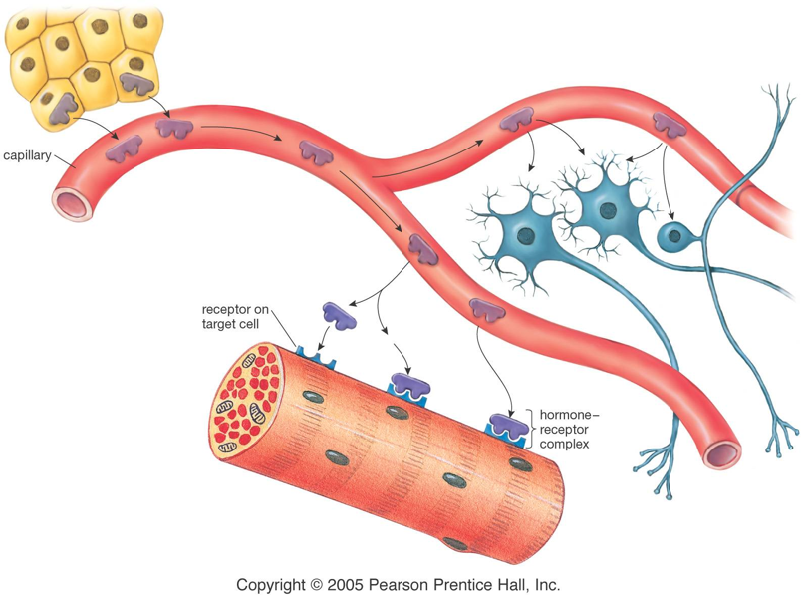
Hormones and Receptors
Notes:
Specific hormones are shaped in different ways. And they bind to receptors that fit their shape.

Slide 3
Hormones and Receptors
Hormones are all shaped differently.
Hormones bind to receptors on target cells that fit their shape – like a lock and key.
Only the correct hormone is able to affect the target cell.
Notes:
Specific hormones are shaped in different ways. And they bind to receptors that fit their shape.

Slide 4
Hormones and Receptors
Notes:
Specific hormones are shaped in different ways. And they bind to receptors that fit their shape.

Slide 5
Negative Feedback
Negative feedback is how your endocrine system maintains homeostasis.
The secretion of hormones are turned on or off due to changes in your body.
Notes:
Homeostasis is maintaining constant enviro

Slide 6
Negative Feedback Loop Structure
Stimulus – the change
Receptor- what recognises the change (e.g. gland)
Modulator- the gland and the hormone released
Effector- what the hormone acts on
Response – the new outcome of the hormone
Feedback – returns body to homeostasis

Slide 7
Insulin Negative Feedback

Slide 8
Recap
Define metabolism

Slide 9
Recap
Define glucose

Slide 10
Recap
Where does insulin come from?

Slide 11
Recap
What are the first 3 steps of a negative feedback loop?

Slide 12
Recap
Define glycogen

Slide 13
Recap
What step 4-6 of a negative feedback loop?

Slide 14
Recap
Why does the endocrine system need negative feedback loops?

Slide 15
Recap
Draw a target cell with receptors and hormones

Slide 16
Recap
Draw the insulin feedback loop

Slide 17
Glucagon Negative Feedback

Slide 18
W
O
R
K
T
O
G
E
T
H
E
R
Activity
Create a video showing the negative feedback for one of the following on metabolism
Insulin
Glucagon
Thyroxine

Slide 19
Activity
Think about the videos we have watched previously.
The video should be 3 minutes long
W
O
R
K
T
O
G
E
T
H
E
R

Slide 20
Activity
You must also have a worksheet/activity for the class to complete will they are watching your video.
W
O
R
K
T
O
G
E
T
H
E
R

